Slide 1
CS 463 Natural Language Processing
Dr. Saleh Haridy
2023-2024

Slide 2
CS 463: NLP
Course Code: CS 463 Credits: 3 (3 Lec., 1 Lab, 0 Tutorial)
Instructure: Dr. Saleh Haridy
Textbook:
Jurafsky and Martin, “SPEECH and LANGUAGE PROCESSING: An Introduction to Natural Language Processing, Computational Linguistics, and Speech Recognition”, Third Edition, McGraw Hill, 2023.
References:
Jacob Eisenstein, “Natural Language Processing”, November 13, 2018
Manning and Schutze, "Statistical Natural Language Processing", MIT Press; 1st edition (June 18, 1999), ISBN: 0262133601
Online Resources:
https://docs.python.org/3.10/tutorial/introduction.html
https://www.nltk.org/
https://www.nltk.org/book/
Lectures:
As per schedule

Slide 3
Evaluation and Grading Policy
Midterm Exam: | 20
Two Quizzes | 20
Mini Projects | 10
Exercises | 10
Final Exam: | 40
Total | 100

Slide 4
Course objectives
To learn about Regular Expressions and Text Normalization and Edit Distance.
To understand Language modeling using N-Gram and neural network models
To design Text classification using Naïve Bayes, logistic regression, neural networks
To understand vector semantics and embedding
To understand Deep Learning language models and Chatbot

Slide 5
Course Contents
Week | Course Topics | Book’s Chapter | Event Name
1 | Introduction and Overview | 1
2 | Regular Expressions, Text Normalization | 2
3 | Minimum Edit Distance and Alignment | 2
4 | N-gram Language Models | 3 | TEST 1
5 | Naive Bayes and Sentiment classification | 4
6 | Text classification using logistic regression | 5
7 | Midterm Exam
8 | Vector Semantics and Embedding | 6
9 | Neural Language Model I | 7
10 | Neural Language Model II | 7
11 | Part of Speech Tagging | 8 | TEST 2
12 | Deep Learning Architectures for Sequence Processing | 9
13 | Chatbots & Dialogue Systems I | 24
14 | Chatbots & Dialogue Systems II | 24
15 | FINAL EXAM
Notes:
My presentation about ….
This presentation present a new modification for SOM learning algorithm that use Mahalanobis distance instead of Euclidean distance.

Slide 6

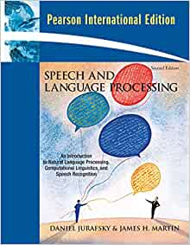
Textbook

Slide 7
Week 1
Introduction to Natural Language Processing

Slide 8
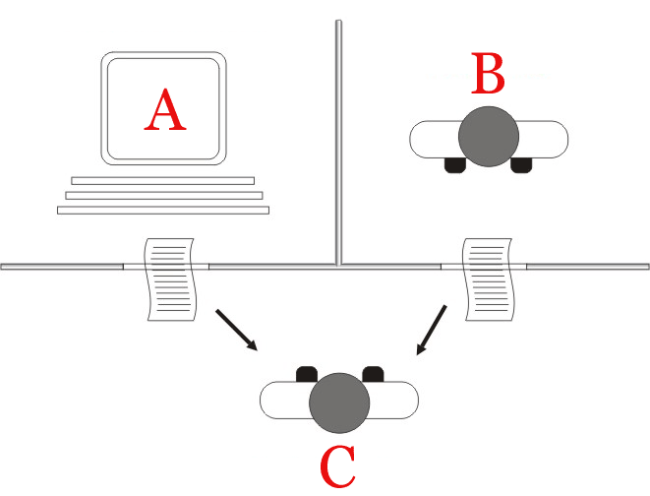
What is Natural language processing?
Natural language processing (NLP) refers to the branch of artificial intelligence or AI— concerned with giving computers the ability to understand text and spoken words in much the same way human beings can.
Natural language processing has its roots in the 1950s when Alan Turing proposed what is now called the Turing test as a criterion of intelligence. The proposed test includes a task that involves the automated interpretation and generation of natural language.
Turing Test
Human evaluator (C) judge natural language conversations between a human (A) and a machine (B) programmed to generate human-like responses

Slide 9
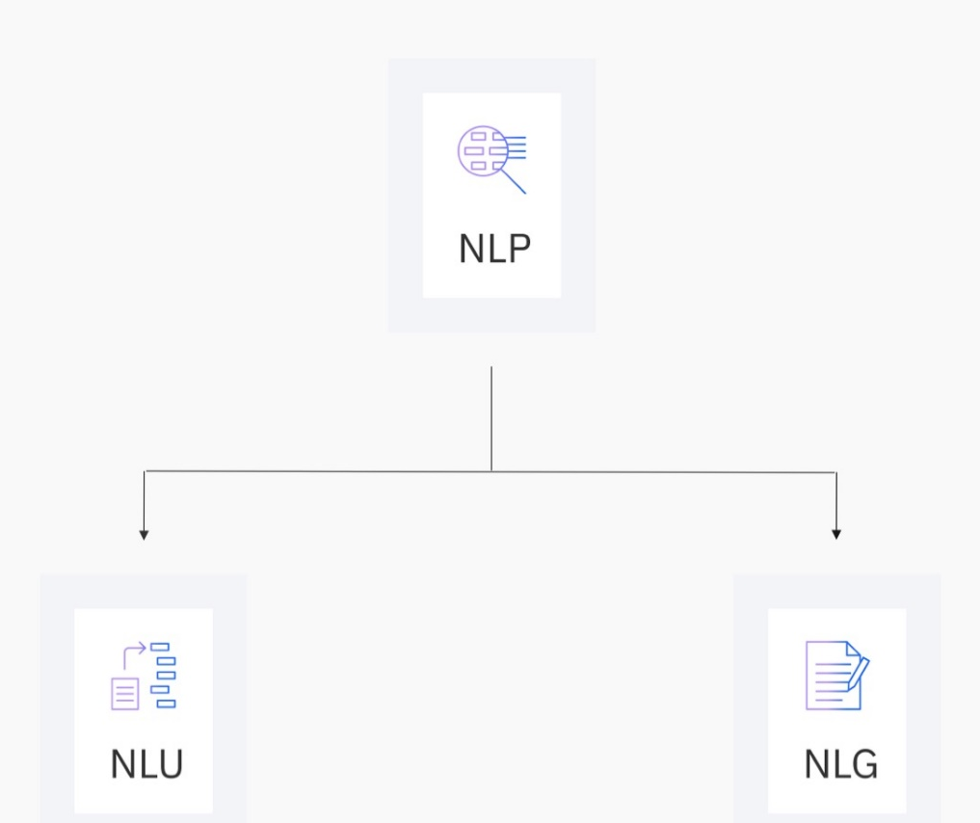
Natural language Processing/Understanding/Generation (NLP/NLU/NLG)?
NL ∈ {Arabic, Hindi, Spanish, Urdo, English, … Turkish}
Natural language understanding (NLU) is a subset of natural language processing, which uses syntactic and semantic analysis of text and speech to determine the meaning of a sentence.
Natural language generation NLG is the process of producing a human language text response based on some data input. This text can also be converted into a speech format through text-to-speech services.

Slide 10
Applications
Machine Translation (Google translate,..)
Question Answering (Information retrieval + NLP): IBM Watson
Dialogue Systems (digital assistant)/Chatbots (casual conversation): Siri, Cortana, Alexa, Google Assistant,chatGPT,…
Text Summarization (QuillBot , SummarizeBot, Resoomer,
Sentiment Analysis (MonkeyLearn, Lexalytics, Brandwatch,…)
...
20

Slide 11
Machine translation
Google Translate is an example of widely available NLP technology at work.
Machine translation involves more than replacing words in one language with words of another.
Effective translation has to capture accurately the meaning and tone of the input language and translate it to text with the same meaning and desired impact in the output language.
A great way to test any machine translation tool is to translate text to one language and then back to the original.

Slide 12
Virtual agents and chatbots
Virtual agents such as Apple's Siri, Google Assistant, Samsong Bixby, and Amazon's Alexa use speech recognition to recognize patterns in voice commands and natural language generation to respond with appropriate action or helpful comments.
Chatbots can answer various questions asked during an interactive conversation.
Interactive conversation means the system keeps a track of questions asked earlier and can engage in longer conversations.
They have a sought of memory which helps answer in a more friendlier manner. Also, they retrieve information such as weather, stock prices from various sources. Hence, their ability is far beyond Q&A systems in this sense.

Slide 13
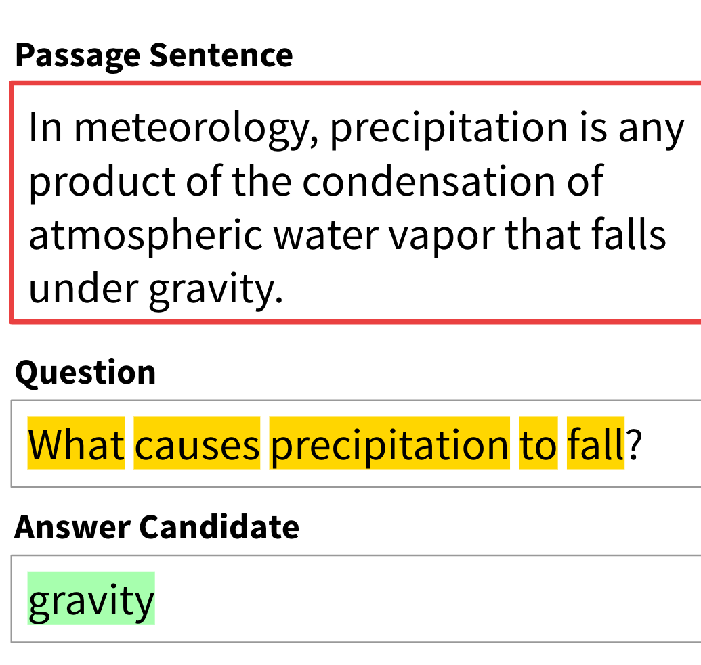
Question Answering (QA)
The purpose of QA is to locate the text for any new question that has been addressed.
It is programmed to answer questions only from a particular source of information of sometimes questions belonging to a common topic.
They could be thought of a search engine which only works for a specific topic.

Slide 14
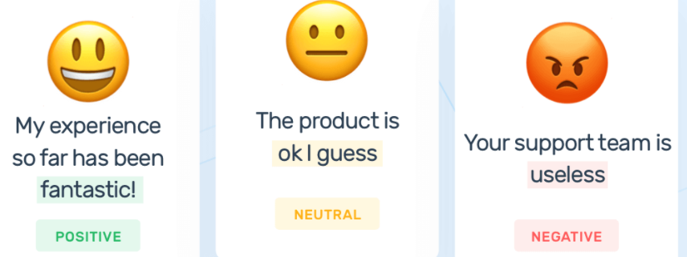
Sentiment analysis
NLP is an essential business tool for uncovering hidden data insights from social media channels.
Sentiment analysis can analyze language used in social media posts, responses, reviews, and more to extract attitudes and emotions in response to products, promotions, and events–information companies can use in product designs, advertising campaigns, and more.

Slide 15
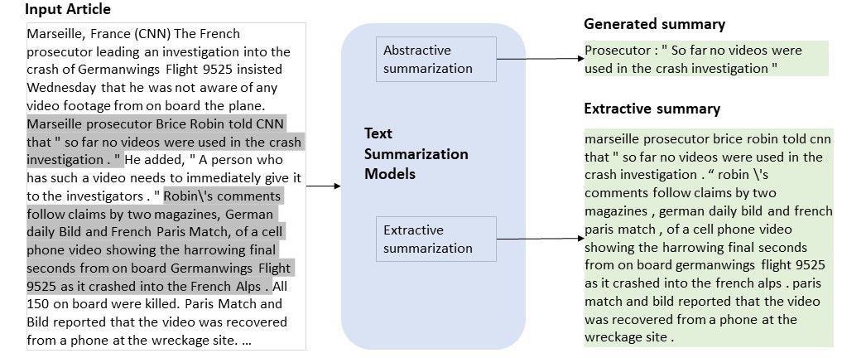
Text summarization
Text summarization uses NLP techniques to digest huge volumes of digital text and create summaries and synopses for indexes, research databases, or busy readers who don't have time to read full text.

Slide 16
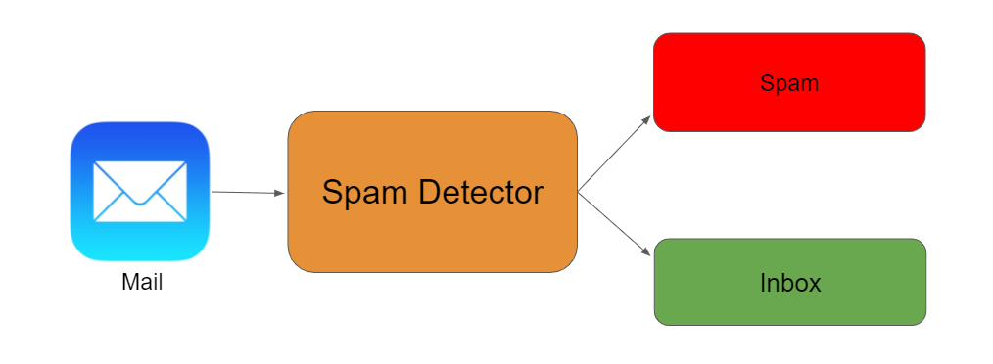
Spam detection
Spam detection use NLP's text classification capabilities to scan emails for language that often indicates spam or phishing.
These indicators can include overuse of financial terms, characteristic bad grammar, threatening language, inappropriate urgency, misspelled company names, and more.

Slide 17




Current situation of NLP technologies
making good progress
Sentiment analysis
still really hard
mostly solved
Best roast chicken in San Francisco!
Question answering (QA)
The waiter ignored us for 20 minutes.
Spam detection
Coreference resolution
Q. How effective is ibuprofen in reducing fever in patients with acute febrile illness?
✓
Let’s go to Agra!
✗
Carter told Mubarak he shouldn’t run again.
Paraphrase
Buy V1AGRA …
Word sense disambiguation (WSD)
I need new batteries for my mouse.
XYZ acquired ABC yesterday
Part-of-speech (POS) tagging
ABC has been taken over by XYZ
ADJ ADJ NOUN VERB ADV
Parsing
Summarization
Colorless green ideas sleep furiously.
The Dow Jones is up
Economy is good
I can see Alcatraz from the window!
The S&P500 jumped
Named entity recognition (NER)
Machine translation (MT)
Housing prices rose
PERSON ORG LOC
第13届上海国际电影节开幕…
Dialog
Where is Citizen Kane playing in SF?
Einstein met with UN officials in Princeton
The 13th Shanghai International Film Festival…
Information extraction (IE)
Castro Theatre at 7:30. Do you want a ticket?
You’re invited to our dinner party, Friday May 27 at 8:30
Party May 27 add

Slide 18
How to Acquire Knowledge from Language?
What distinguishes language processing applications from other data processing systems is their use of knowledge of language.
Assume you write a program to chat with a human,
It should recognize words from audio signal, so it requires knowledge about phonetics and phonology.
Should know that “doors” is plural, it require morphological analysis of word.
It must be able to concatenate words properly to create a sentence. This require knowledge of a syntax analysis.
To answer a question, it should know the meaning of each words (lexical semantics), as well as compositional semantics
It should know the tone of speaker, so decide the action by using pragmatic or dialogue knowledge.
It makes use of knowledge about how words like that or pronouns like it or she refer to previous parts of the discourse (coreference resolution).

Slide 19
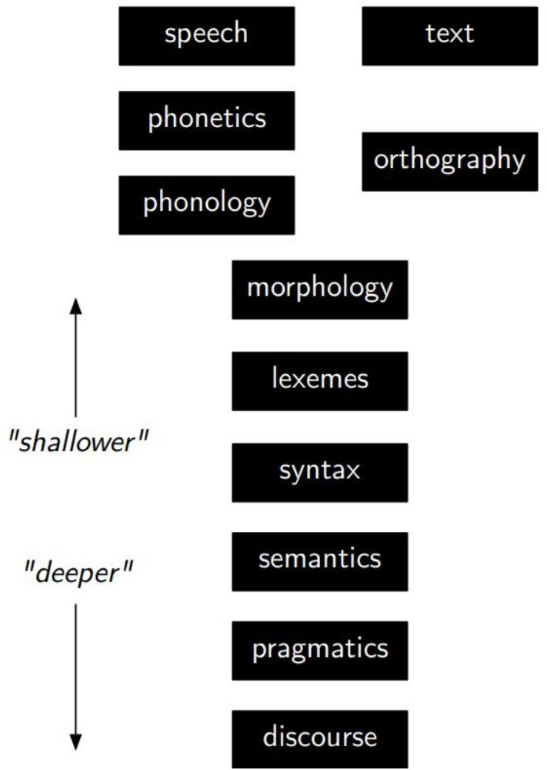
NLP tasks
Phonetics and Phonology: knowledge about linguistic sounds
Morphology/lexemes: Knowledge of meaningful component of word, it concerns the way words are built up from smaller meaning bearing units. .
Syntax: Knowledge of the structural relationships between words, it concerns how words are put together to form correct sentences.

Slide 20
NLP tasks
Semantics: knowledge of meaning, it concerns what words mean and how these meanings combine in sentences to form sentence meanings
Pragmatics: knowledge of the relationship of meaning to the goals and intentions of the speaker. It concerns how sentences are used in different situations and how use affects the interpretation of the sentence.
Discourse: knowledge about linguistic units larger than a single utterance. It concerns how the immediately preceding sentences affect the interpretation of the next sentence

Slide 21
Common NLP tasks
Morphological analysis
Word segmentation (Tokenization): Separate a chunk of continuous text into separate words. For a language like English or Arabic, this is fairly trivial, since words are usually separated by spaces. However, some written languages like Chinese, Japanese and Thai do not mark word boundaries in such a fashion, and in those languages text segmentation is a significant task requiring knowledge of the vocabulary and morphology of words in the language.
Lemmatization: The task of removing inflectional endings only and to return the base dictionary form of a word which is also known as a lemma. Lemmatization is another technique for reducing words to their normalized form. But in this case, the transformation actually uses a dictionary to map words to their actual form.
Stemming: The process of reducing inflected (or sometimes derived) words to a base form (e.g., "close" will be the root for "closed", "closing", "close", "closer" etc.). Stemming yields similar results as lemmatization, but does so on grounds of rules, not a dictionary.

Slide 22
Part-of-speech tagging:
I (pronoun) want (verb)
to (prep)
to(infinitive) print (verb)
Ali (noun)
‘s (possessive) word (adj)
file (noun)
Given a sentence, determine the part of speech (POS) for each word (grammatical category of a word). Many words, especially common ones, can serve as multiple parts of speech. For example, "book" can be a noun ("the book on the table") or verb ("to book a flight"); "set" can be a noun, verb or adjective; and "out" can be any of at least five different parts of speech.
I want to print Ali’s word file
Notes:
In English the main parts of speech are noun, pronoun, adjective, determiner, verb, adverb, preposition, conjunction, and interjection.

Slide 23
Syntactic analysis
Parsing: Determine the parse tree (grammatical analysis) of a given sentence. There are two primary types of parsing: dependency parsing and constituency parsing. Dependency parsing focuses on the relationships between words in a sentence (marking things like primary objects and predicates), whereas constituency parsing focuses on building out the parse tree using a probabilistic context-free grammar (PCFG)
Assigning a syntactic and logical form to an input sentence
uses knowledge about word and word meanings (lexicon)
uses a set of rules defining legal structures (grammar)

Slide 24
Parse Tree
S
NP
VP
I (pronoun) want (verb)
to (prep)
to(infinitive) print (verb)
Ali (noun)
‘s (possessive) word (adj)
file (noun)
V
S
PRO
NP
VP
I
want
PRO
V
NP
ADJ
NP
to
print
ADJ
N
Ali’s
word
file

Slide 25
Lexical semantics (of individual words in context)
Named entity recognition (NER): Given a stream of text, determine which items in the text map to proper names, such as people or places, and what the type of each such name is (e.g. person, location, organization).
Although capitalization can aid in recognizing named entities in languages such as English, this information cannot aid in determining the type of named entity, and in any case, is often inaccurate or insufficient.
For example, the first letter of a sentence is also capitalized, and named entities often span several words, only some of which are capitalized.
Furthermore, many other languages in non-Western scripts (e.g. Chinese or Arabic) do not have any capitalization at all, and even languages with capitalization may not consistently use it to distinguish names.

Slide 26
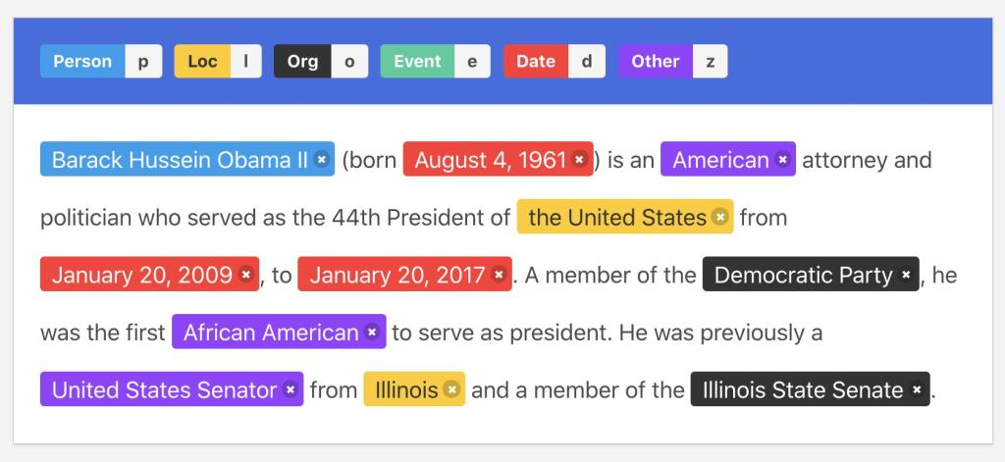
Example of the output of an NER tagger:

Slide 27
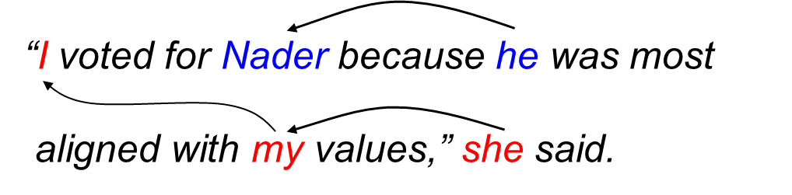
Discourse (semantics beyond individual sentences)
Coreference resolution
Given a sentence or larger chunk of text, determine which words ("mentions") refer to the same objects ("entities").
Anaphora resolution is a specific example of this task, and is specifically concerned with matching up pronouns with the nouns or names to which they refer.
The more general task of coreference resolution also includes identifying so-called "bridging relationships" involving referring expressions.

Slide 28
NLP stages
Syntactic Analysis
user
tokens
Morphological Analysis
parse tree
Surface form
Semantic Analysis
lexicon
Pragmatic Analysis
Perform action
Internal representation
Discourse Analysis
Resolve references

Slide 29

Why NLP is Hard?
Ambiguity
Scale
Sparsity
Variation
Expressivity
Unmodeled Variables
Unknown representations

Slide 30
Ambiguity
More than one meaning for the same sentence
Ambiguity at multiple levels
Word senses: bank (finance or river ?)
Part of speech: chair (noun or verb ?)
Syntactic structure: I can see a man with a telescope
Multiple: I made her duck

Slide 31
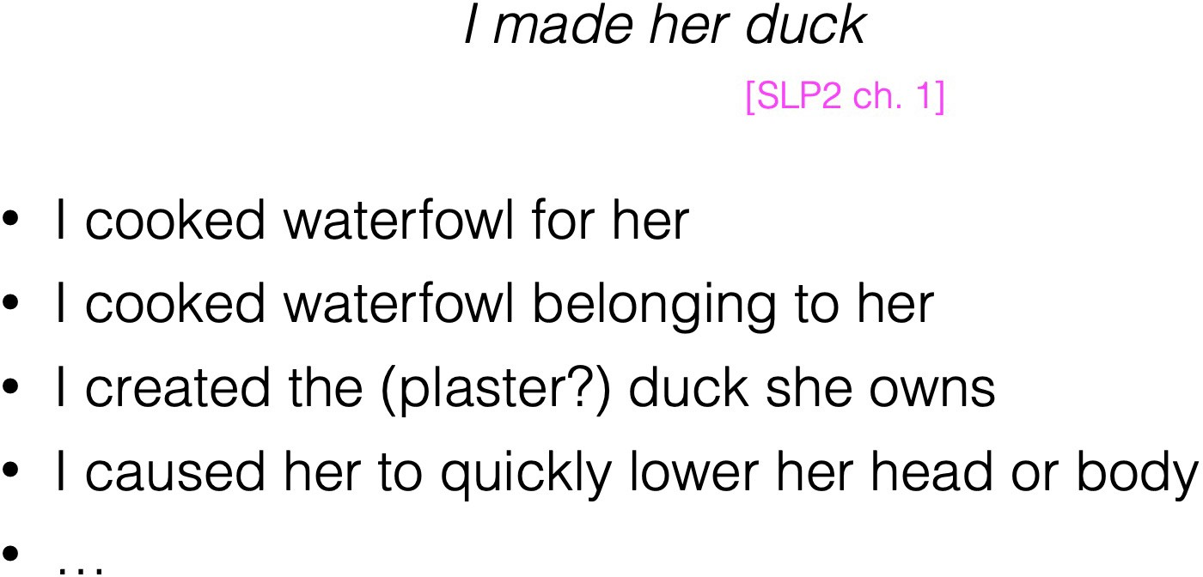
Ambiguity Example
لقد صنعت لها بطة
Save translation
لقد طهيت لها بطة.
لقد قمت بطهي البطة التي تخصها
لقد صنعت البطة (دمية) التي تمتلكها
لقد جعلتها تخفض رأسها أو جسدها بسرعة.
لوحت بعصا السحرية الخاصة بي وحولتها إلى طائر مائي غير متمايز
I waved my magic wand and turned her into undifferentiated duck
First, the words duck and her are morphologically or syntactically ambiguous in their part-of-speech
Duck can be verb or noun
Her can be additive or possessive pronoun
The word make is semantically ambiguous, it can mean create or cook

Slide 32
The Challenges of “Words”
Segmenting text into words
Morphological variation
Words with multiple meanings: bank, mean
Domain-specific meanings: latex
Multiword expressions: make a decision, take out, make up

Slide 33
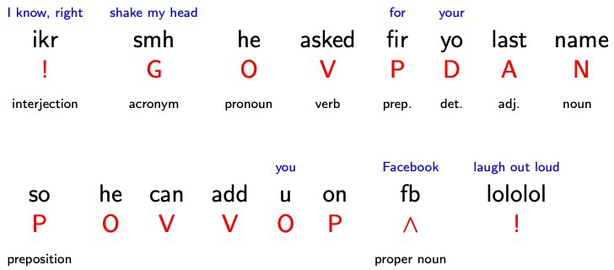
Part of Speech Tagging

Slide 34
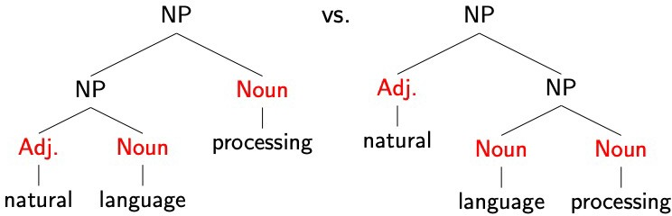
Syntax

Slide 35

Morphology + Syntax
A ship-shipping ship, shipping shipping-ships
سفينة شحن السفن ، تشحن سفن الشحن

Slide 36


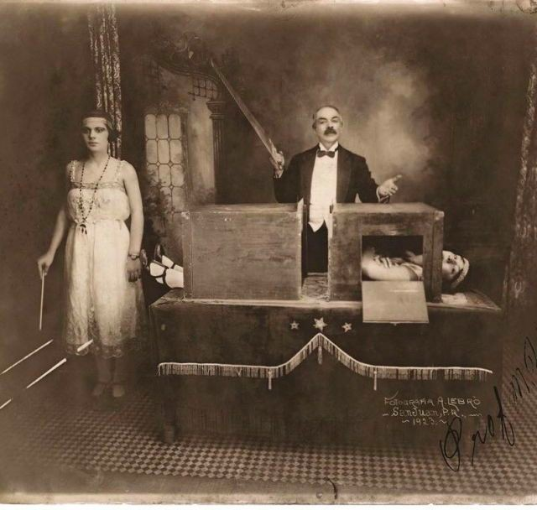
Syntax + Semantics
We saw the woman with the telescope wrapped in paper.
Who has the telescope?
Who or what is wrapped in paper?
An even of perception, or an assault?

Slide 37
Dealing with ambiguity
How can we model ambiguity and choose correct analysis in context?
Non-probabilistic methods return all possible analyses.
Probabilistic models return best possible analysis, i.e. most probable one according to the model.
But the “best” analysis is only good if our probabilities are accurate. Where do they come from?

Slide 38
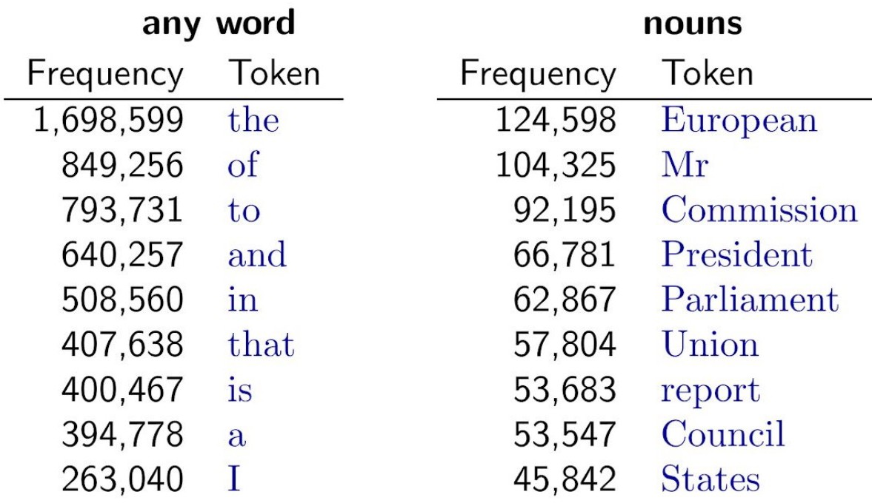
Sparsity
Sparse data due to Zipf’s Law
To illustrate, let’s look at the frequencies of different words in a large text corpus
Assume “word” is a string of letters separated by spaces
Most frequent words in the English Europarl corpus (out of 24m word tokens)
Zipf’s Law
Regardless of how large our corpus is, there will be a lot of infrequent (and zero-frequency!) words
This means we need to find clever ways to estimate probabilities for things we have rarely or never seen

Slide 39
Word counts
Out of 93,638 distinct words (types), 36,231 (~40%) occur only once.
Examples:
cornflakes, mathematicians, fuzziness, jumbling
pseudo-rapporteur, lobby-ridden, perfunctorily
Lycketoft, UNCITRAL, H-0695
policyfor, Commissioneris, 145.95, 27a

Slide 40
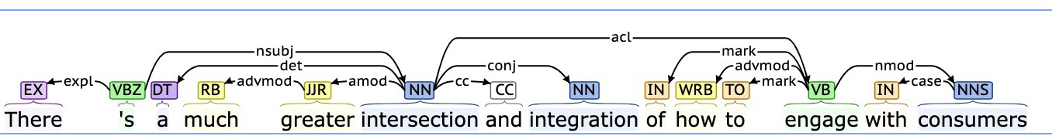


Variation
Suppose we train a part of speech tagger or a parser on the Wall Street Journal…
What will happen if we try to use this tagger/parser for social media?
“ikr smh he asked fir yo last name so he can add u on fb lololol”

Slide 41
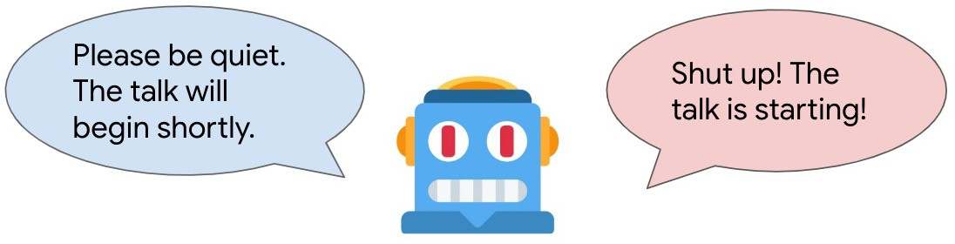
Expressivity
Not only can one form have different meanings (ambiguity) but the same meaning can be expressed with different forms:
She gave the book to Tom vs. She gave Tom the book
Some kids popped by vs. A few children visited
Is that window still open? vs. Please close the window

Slide 42


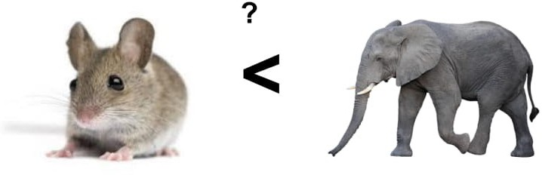
Unmodeled variables
World knowledge
I dropped the glass on the floor and it broke
I dropped the hammer on the glass and it broke
“drink this milk.”
skater eats pavement

Slide 43
Unknown representation
Very difficult to capture what is Rules, since we don’t even know how to represent the knowledge a human has/needs:
What is the “meaning” of a word, sentence, utterance?
How to model context?
Other general knowledge?

Slide 44
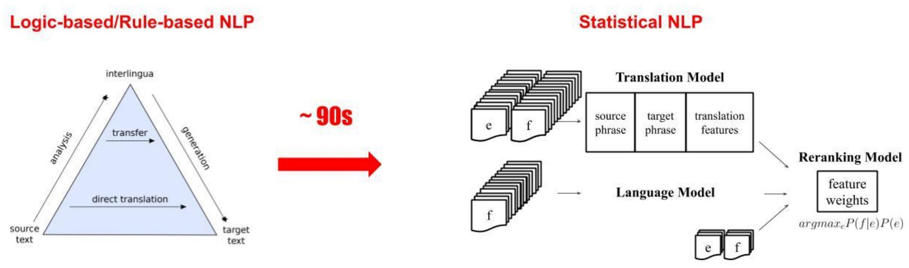
NLP algorithms and methods
Symbolic and Probabilistic NLP

Slide 45
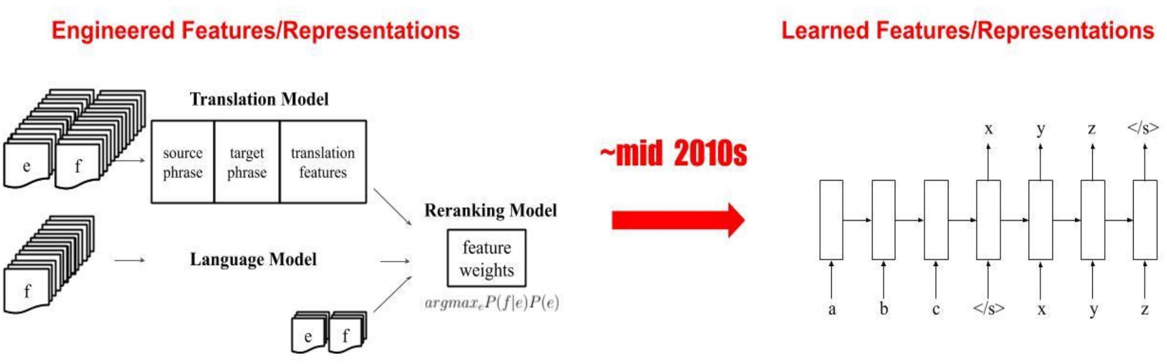
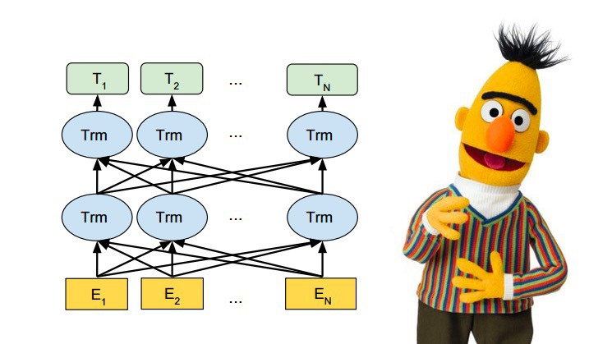
Probabilistic and Connectionist NLP

Slide 46
NLP vs. Machine Learning
NLP focuses on the understanding, processing, and generation of human language, while ML is a broader field that encompasses the development of algorithms and models that can learn from data and make predictions or perform tasks.
To be successful, a machine learner needs bias/assumptions; for NLP, that might be linguistic theory/representations.
Symbolic, probabilistic, and connectionist ML have all seen NLP as a source of inspiring applications.

